Slide 1
EPM problems and solutions…
Gabriele Trovato
23rd to 30th September, 17th EPMeeting, Catania

Slide 2
why EPM?
In EPM , students learn how to write an article, improve their English and more ...

Slide 3
what life is like in EPM?
EPM is a positive experience for the students, where they feel welcome,
as in a family

Slide 4
The most important experiences
But in EPM, the most important experiences are the meetings and hosting foreign students

Slide 5
But…
…there are some problems

Slide 6
Groups
Collaboration among groups isn’t perfect,
and after the new changes
the situation doesn’t look much better

Slide 7
Punctuality and Precision
EPM is a great project, but most of those who are working on it haven’t understood its importance so far, therefore EPM is slowlier than it should be

Slide 8
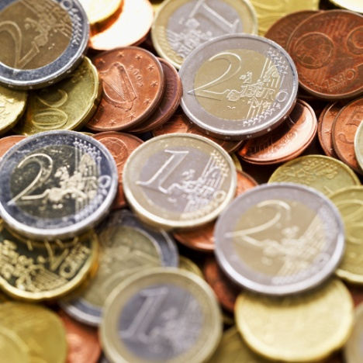
$$$$$$
But this great project needs money,
Lots of money

Slide 9
Publicity and Sponsors
There is a question: where do we get money?
It was thought to some sponsor,
but this doesn't change the structure of the magazine?

Slide 10
IDEAs
But there are some ideas for the future…

Slide 11
Young…
Today students study better using a computer,
so in EPM could be created a “Students Section”

Slide 12
…and Technology
Technology is everywhere, so EPM needs to update

Slide 13
And the magazine?
There was a question:
And if the magazine will be in English only?

Slide 14
Benefits
The publishing and writing work could be halved
There could be more articles

Slide 15
Disadvantages
Should be written more articles
The identity of the Nations would be lost

Slide 16
But shall I call a spade a spade?
23rd to 30th September, 17th EPMeeting, Catania
How can I tell some groups that they are lazy?
WAKE UP!!!
There’s a magazine to manage

Slide 17
And what do you think?
Gabriele Trovato
23rd to 30th September, 17th EPMeeting, Catania

Slide 18
Gabriele
Trovato
23th to 30th
September
17th EPMeeting Catania
Thanks for your attenction

